Slide 1

WAY TO ENTERPRISE
Spring Framework

Slide 2
Agenda
Top-down Coding & Bottom-up Coding
SOLID principles
IoC & DI
Spring core
Spring introduction
Cross Origin
Assignments
Copyright © VTI Academy All Rights Reserved

Slide 3
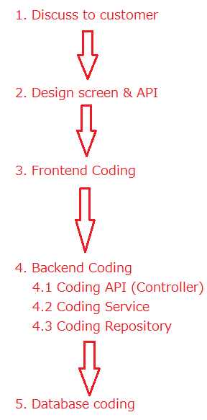
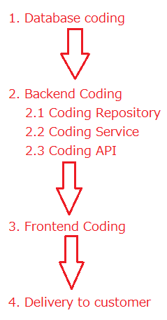
Top-down Coding & Bottom-up Coding
Bottom-up coding
Top-down coding

Slide 4
Top-down Coding & Bottom-up Coding
Bottom-up Coding
  Easy to miss customer requirement
  Familiar to student
Top-down Coding (recommended)
  Focus to customer requirement
  Familiar to employee

Slide 5
SOLID Principles
SOLID makes the code easier to refactor and maintain, but takes longer to write
Principles
  1. Single responsibility
  2. Open/closed
  3. Liskov substitution
  4. Interface segregation
  5. Dependency inversion

Slide 6
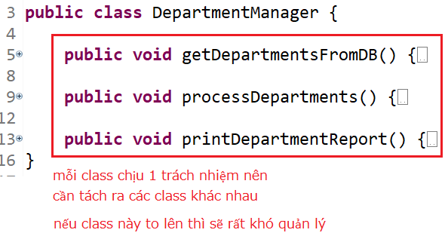
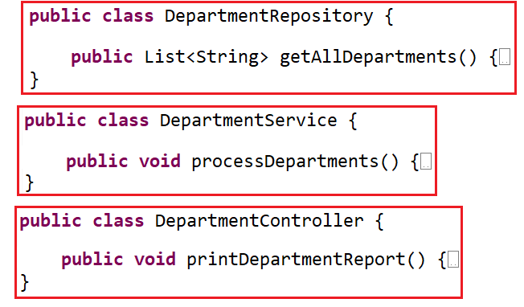
SOLID Principles
1. Single responsibility
  A class should only hold 1 responsibility ➔ Classes can only be modified for only a reason

Slide 7
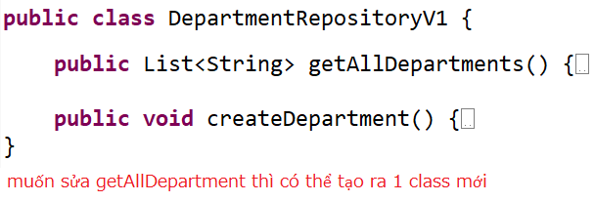
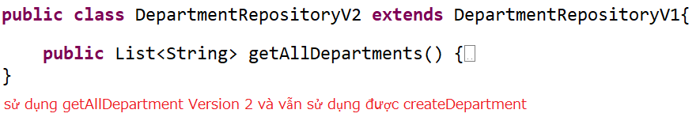
SOLID Principles
2. Open/closed
  It is possible to extend a class freely, but not modify it within that class
  When you want to add functionality to the project, you should write a new class that is an extension of the old class (extend or has-a)

Slide 8
SOLID Principles
3. Liskov substitution
  In a program, objects of SubClass can replace SuperClass without changing the correctness of the program
4. Interface segregation
  Divide the large interface into many small interfaces with specific purposes

Slide 9

SOLID Principles
5. Dependency inversion
  High-level modules should not depend on low-level modules (has-a relationship)
    ➔ Both should depend on abstraction/interface
  Interface (abstraction) should not depend on details, but the opposite.
  Classes communicate with each other through interfaces, not through implementations.

Slide 10
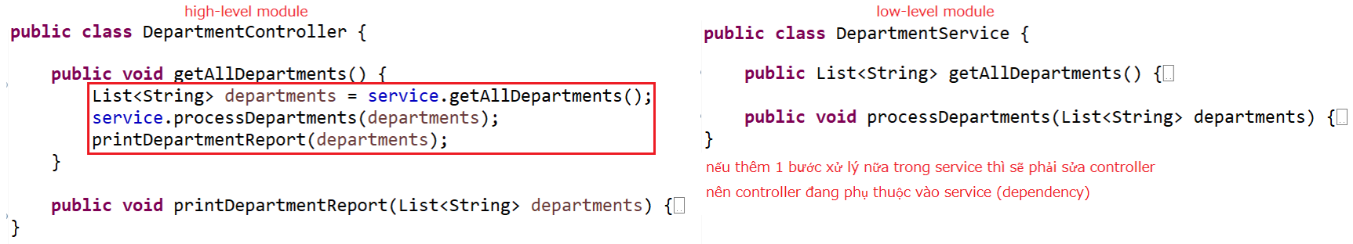
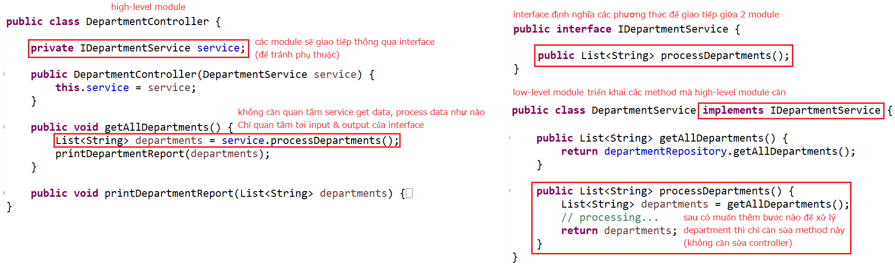
SOLID Principles
Dependency

Slide 11
Inversion of Control
Is a design pattern created to make the code compliant with Dependency Inversion
Provides a simple mechanism to manage dependencies, object initialization
2 ways
  Dependency Injection
  Dependency Lookup (self-study)

Slide 12
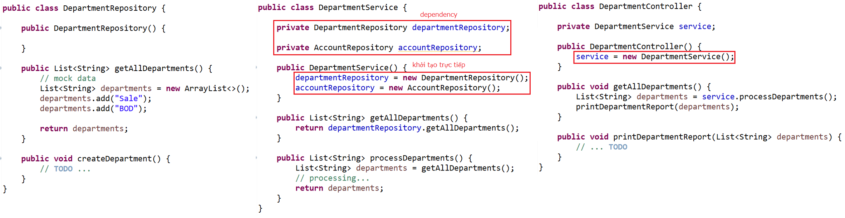
Dependency Injection
Problem

Slide 13
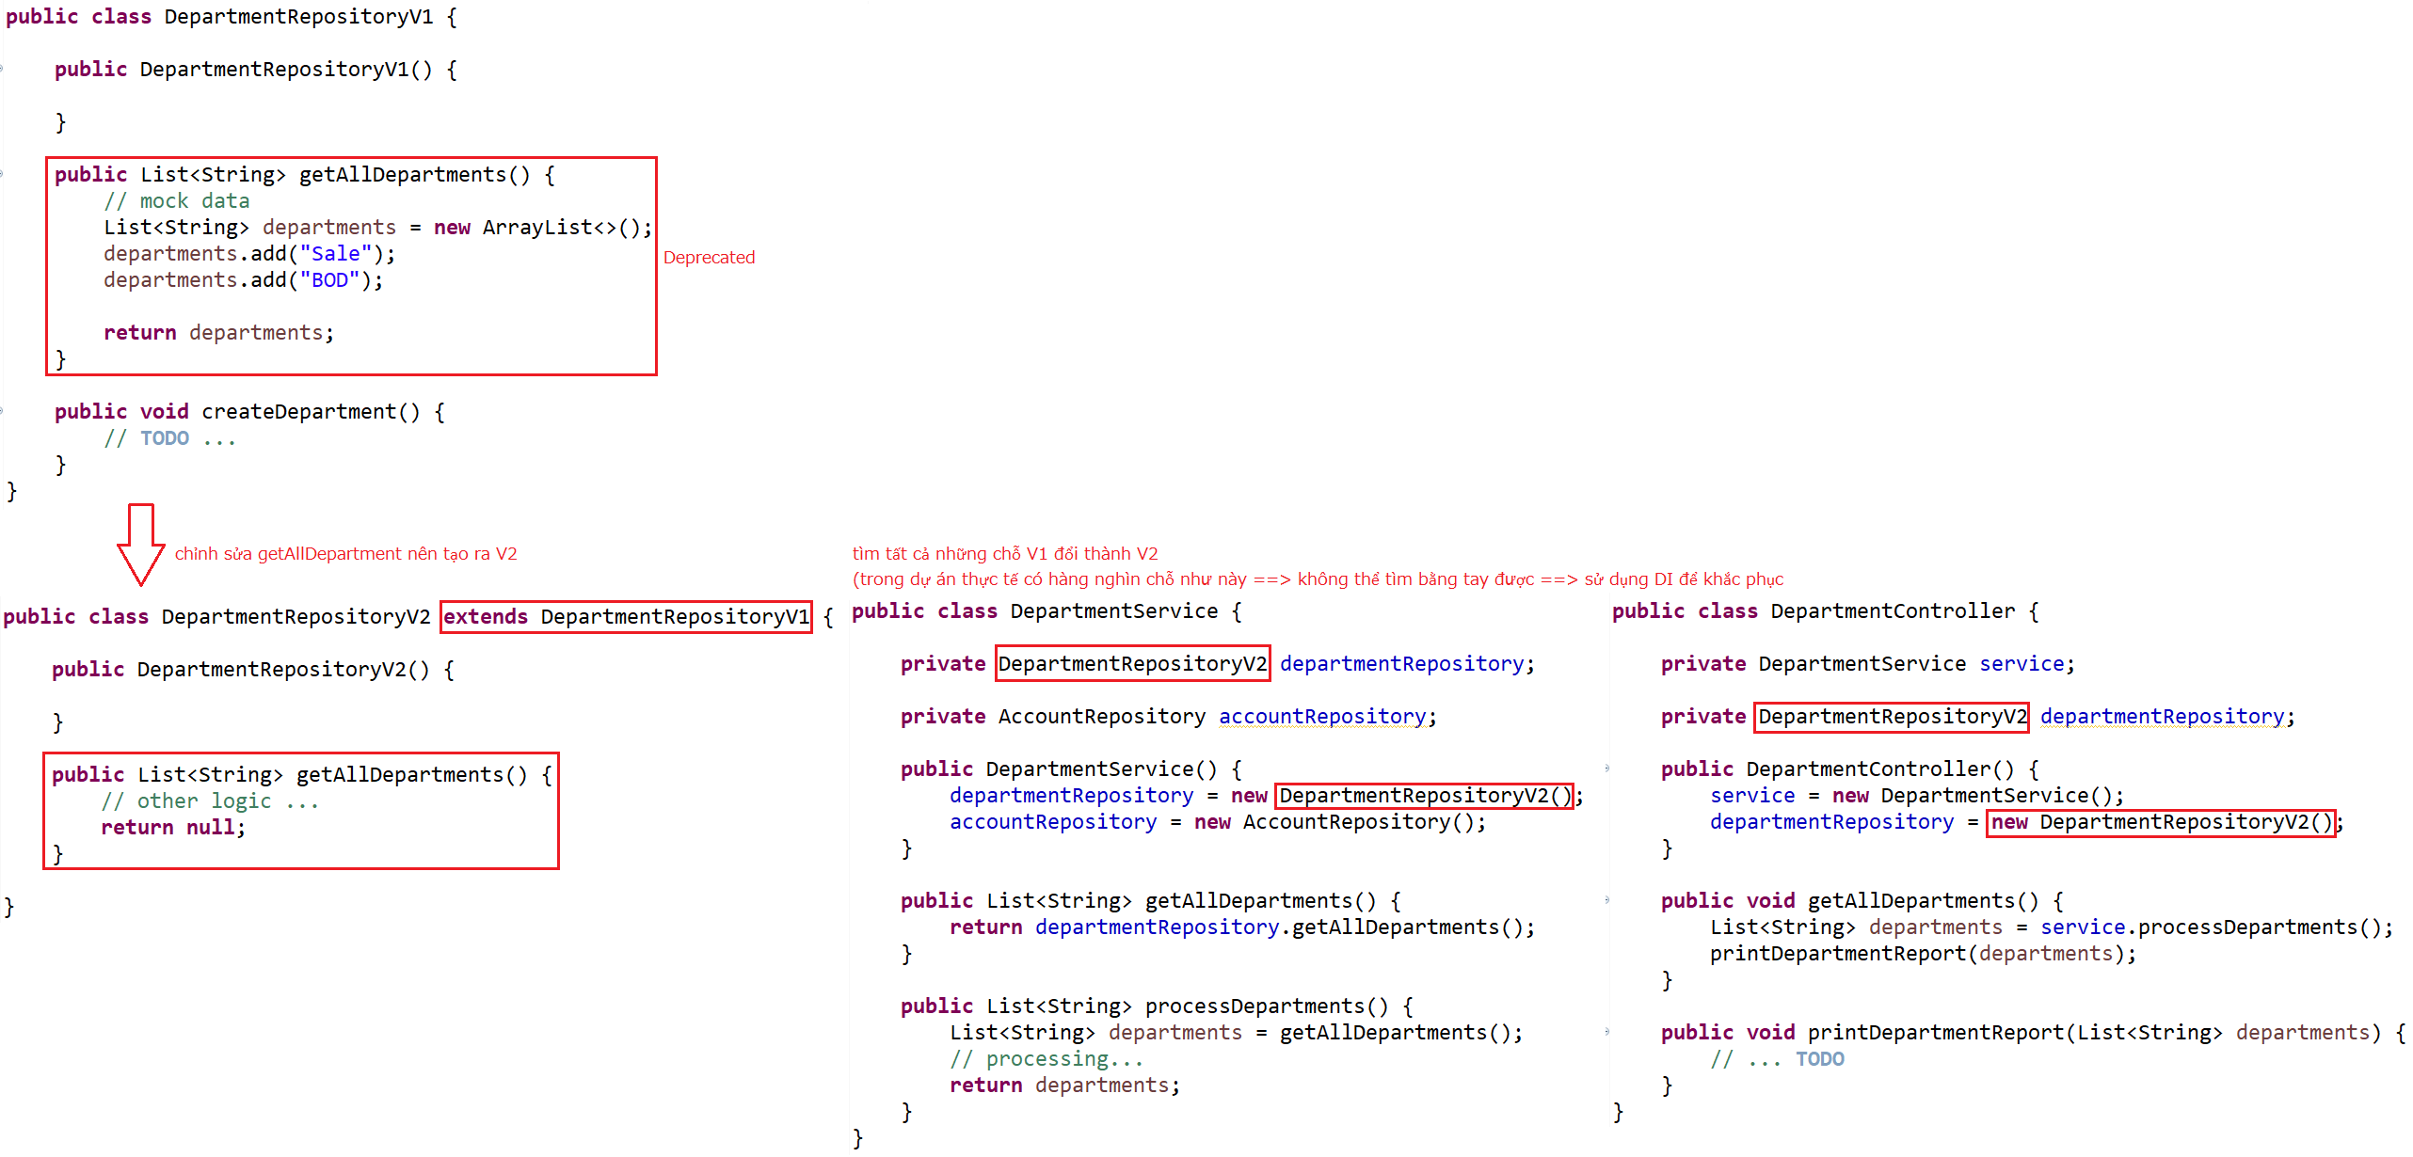
Dependency Injection
When you change the code in the low-level module, you will have to change it on the high-level module too

Slide 14
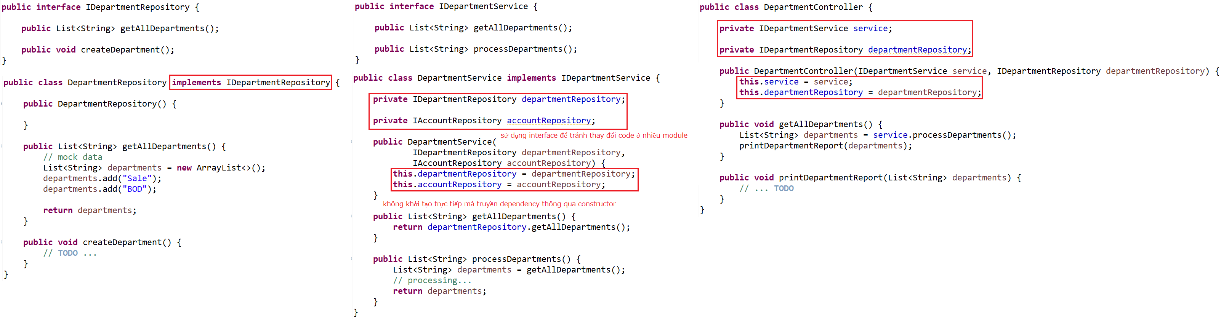
Dependency Injection
Using DI
Setup Component

Slide 15
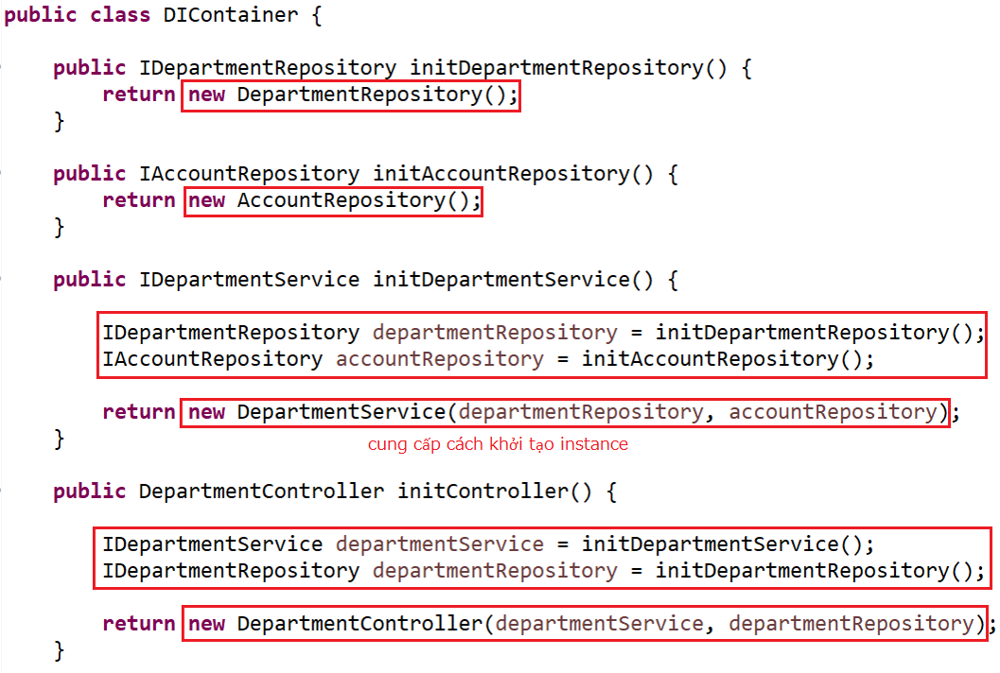
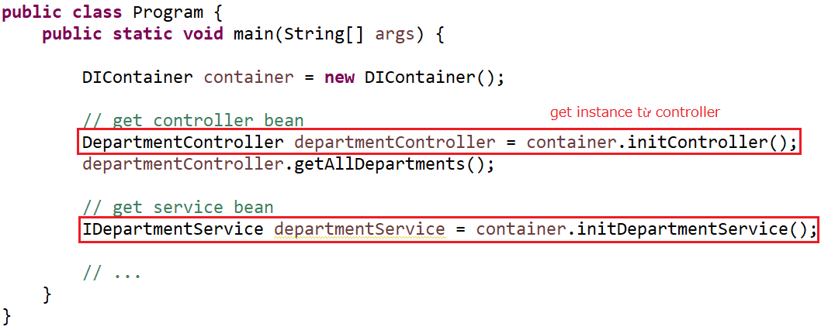
Dependency Injection
Using
Setup DIContainer & Bean

Slide 16
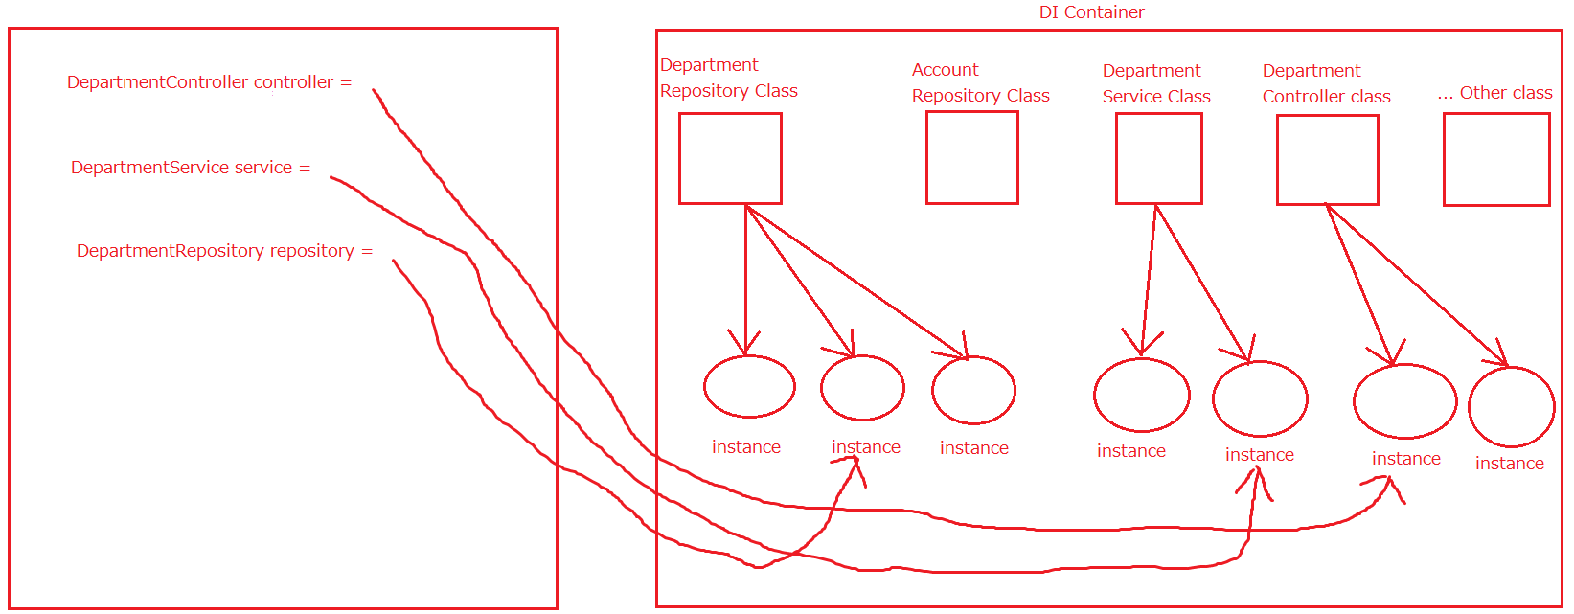
Dependency Injection
Summary

Slide 17
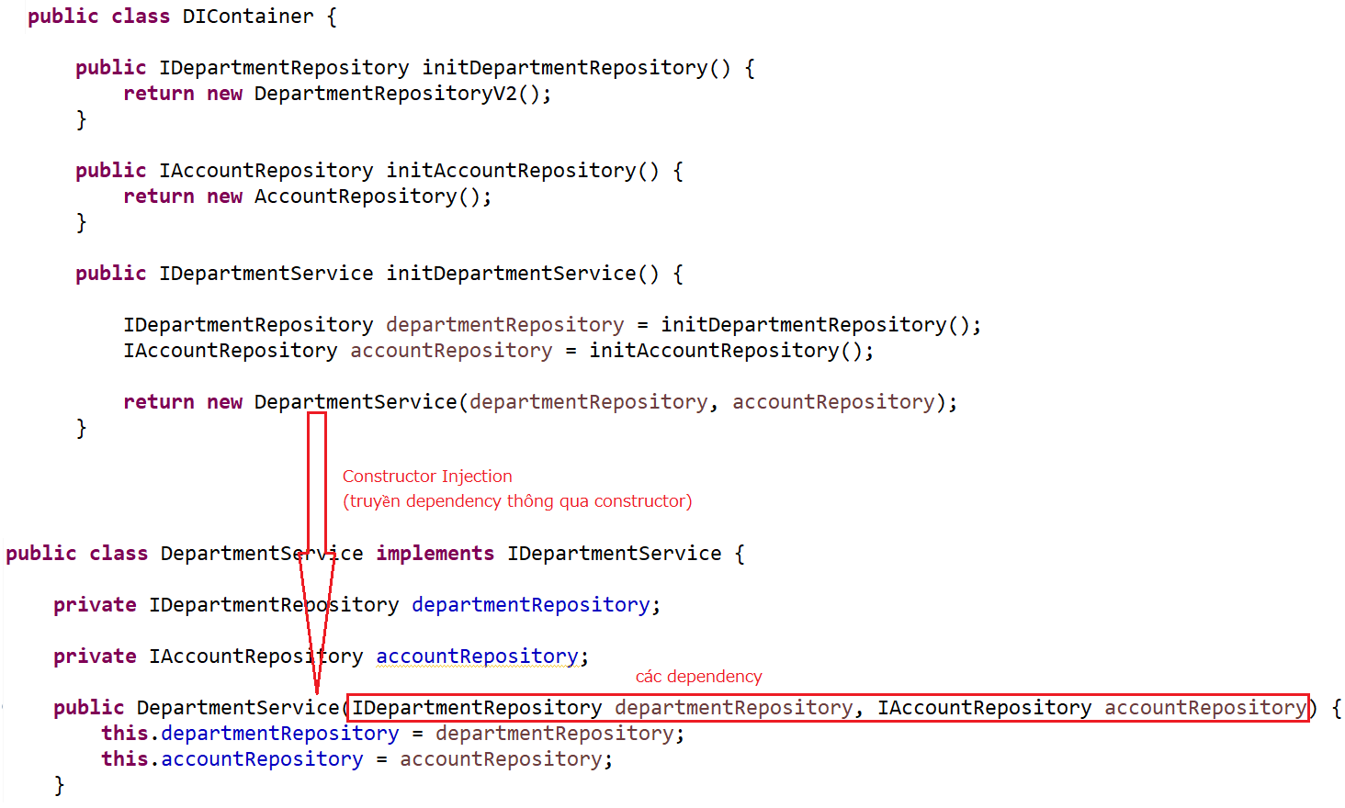
Dependency Injection
Injection

Slide 18
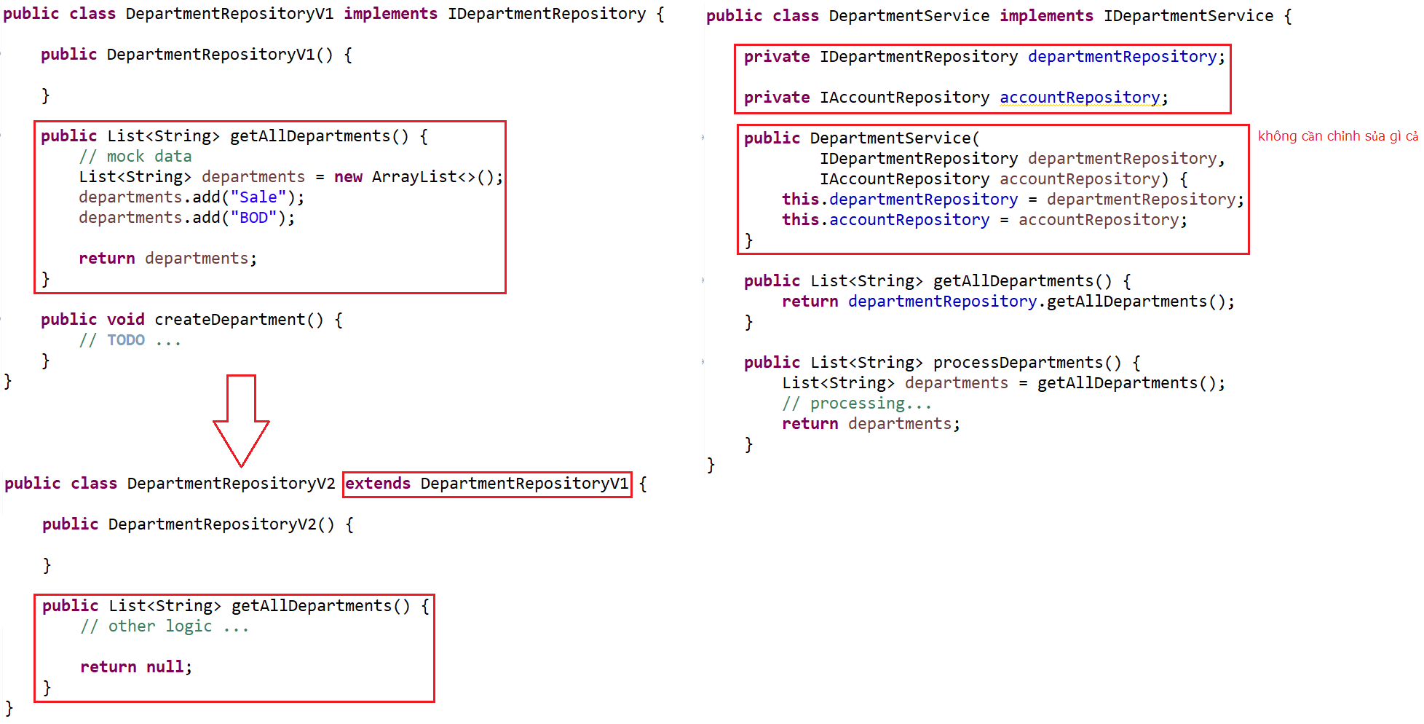
Dependency Injection
Changing code

Slide 19
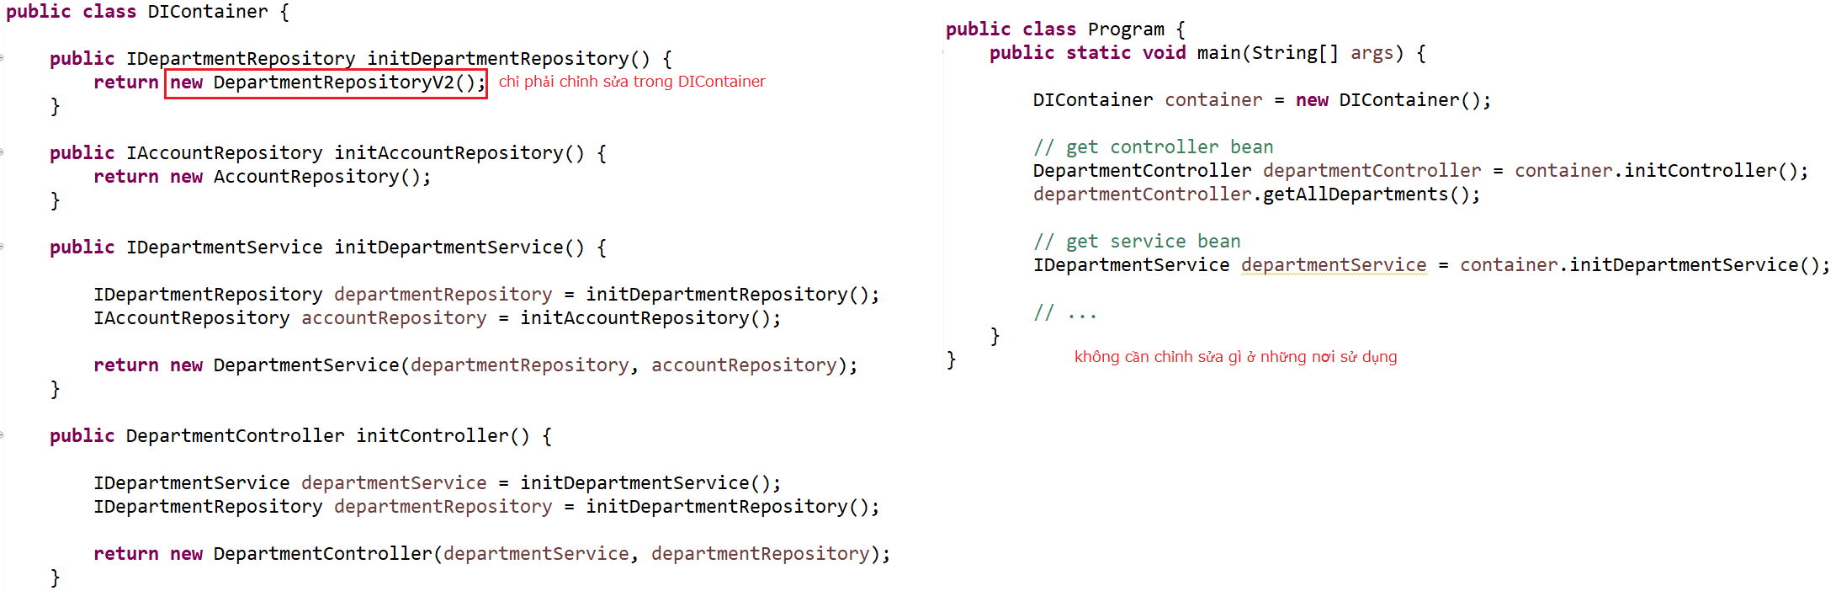
Dependency Injection

Slide 20
Dependency Injection
Dependency modules will be injected into high-level modules
DI is used to reduce dependencies between modules
➔ Easier in module change, code maintenance and testing.
3 Injection ways:
  Constructor Injection
  Setter Injection
  Interface Injection (Self-study)

Slide 21
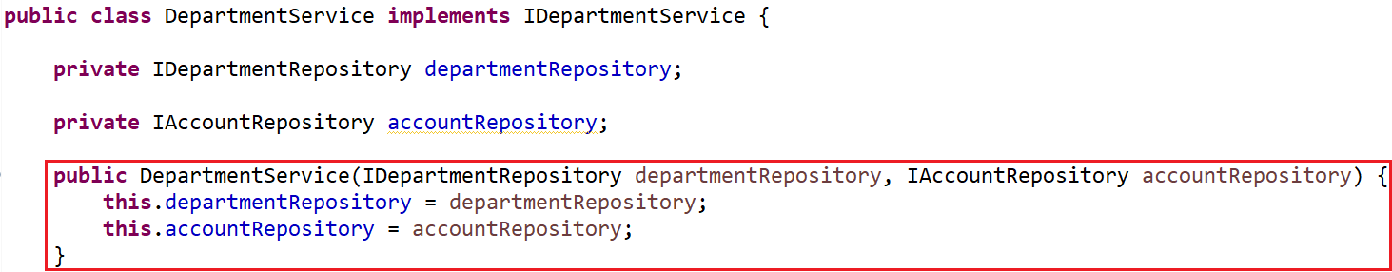
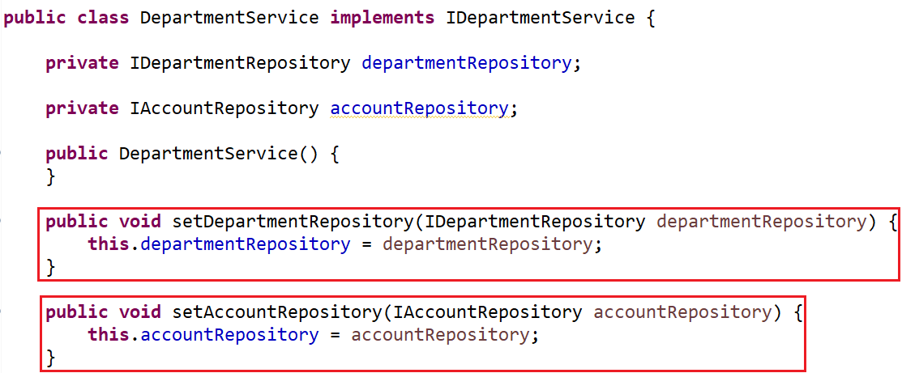
Dependency Injection
Constructor Injection
Setter Injection

Slide 22
Dependency Injection
Advantages & Disadvantages
Advantages | Disadvantages
Reduce adhesion between modules | Confusing DI concept
Easy to maintain | Using interfaces ➔ difficult to debug (we do not know exactly which module is called)
Very easy to test and write Unit Test | Increases the complexity of the code

Slide 23
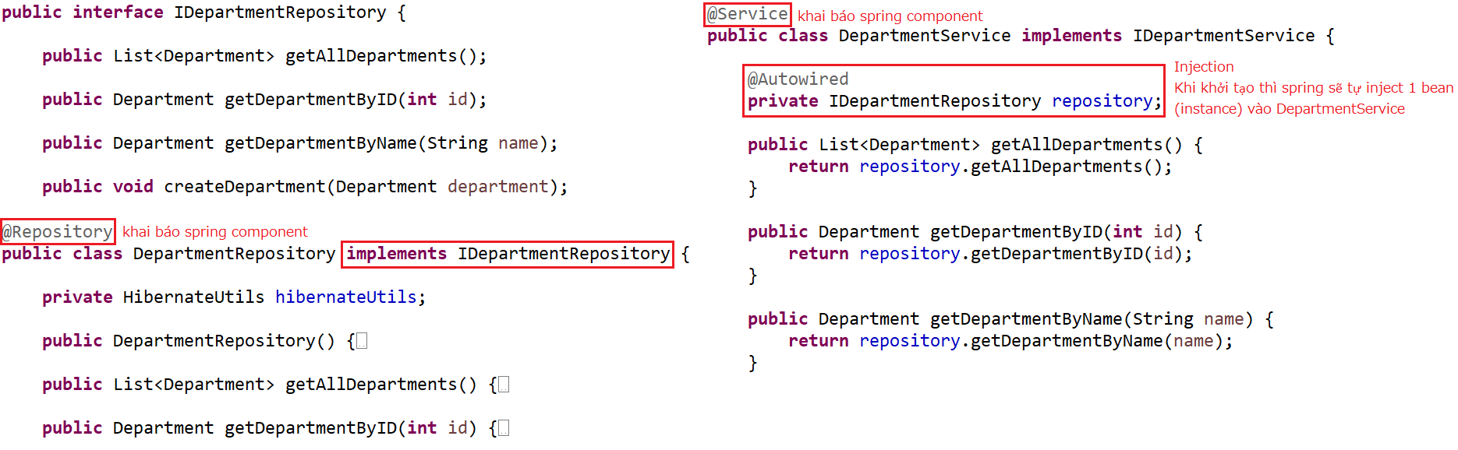
Spring Core
Spring Bean, Spring Component, Spring IOC container

Slide 24
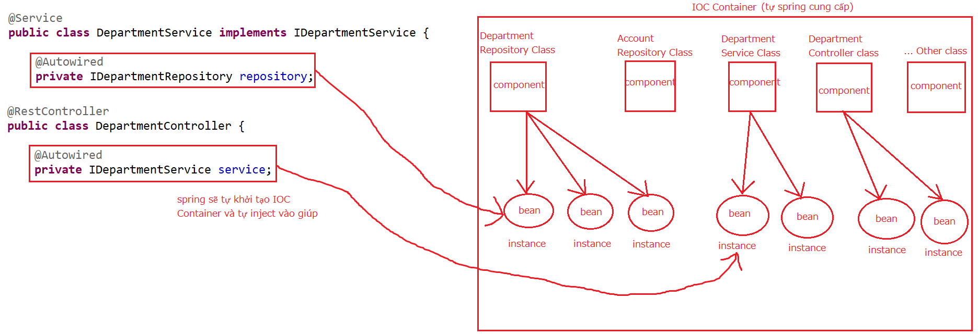
Spring Core
@Autowired

Slide 25
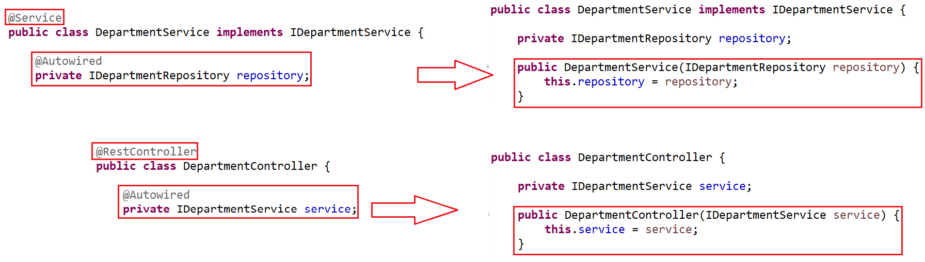
Spring Core

Slide 26
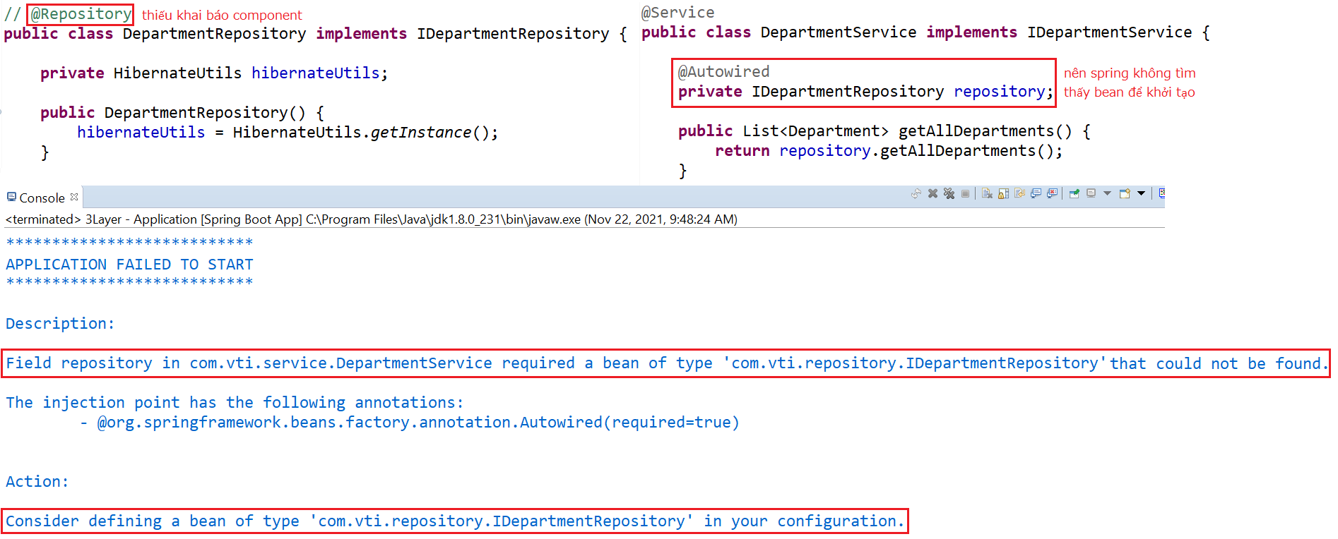
Spring Core
Common Error

Slide 27
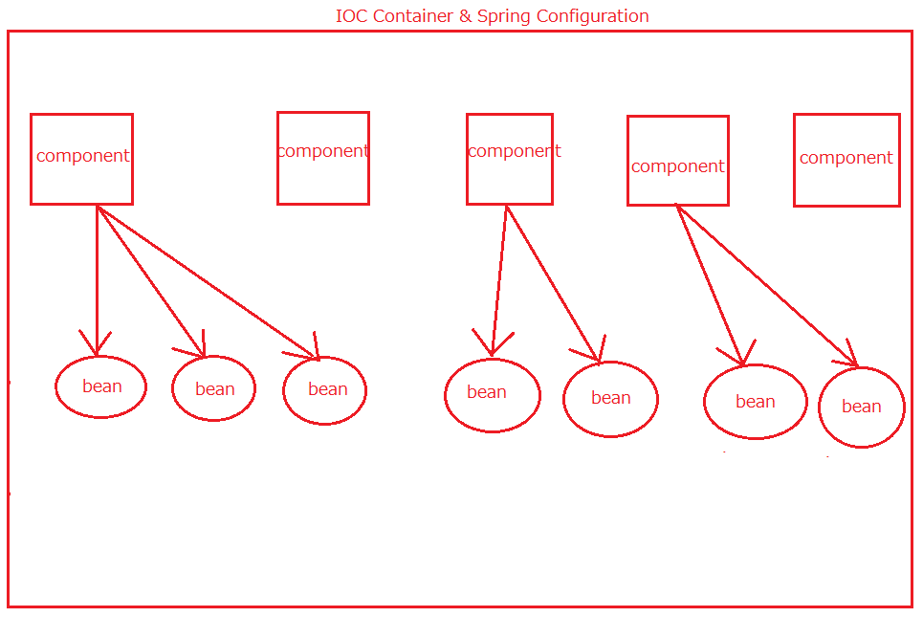
Spring Core
Spring Core component
  Spring Component
  @Scope
  @Autowired & @Qualifier

Slide 28
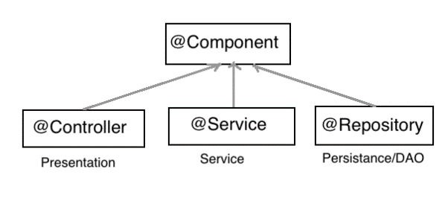
Spring Core
Spring component
  @RestController, @Service, @Repository: using for Controller, Service, Repository Object
  @Component: using for Other Object
  @Configuration, @Bean: using for IOC Container

Slide 29
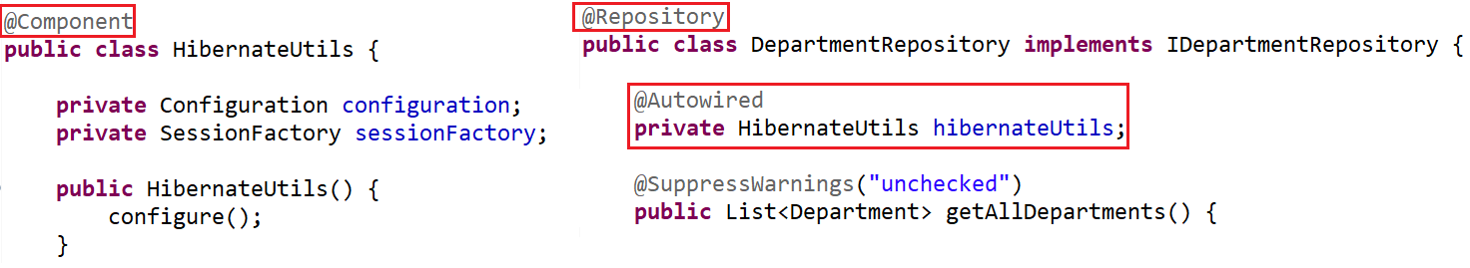
Spring Core
  @Component

Slide 30
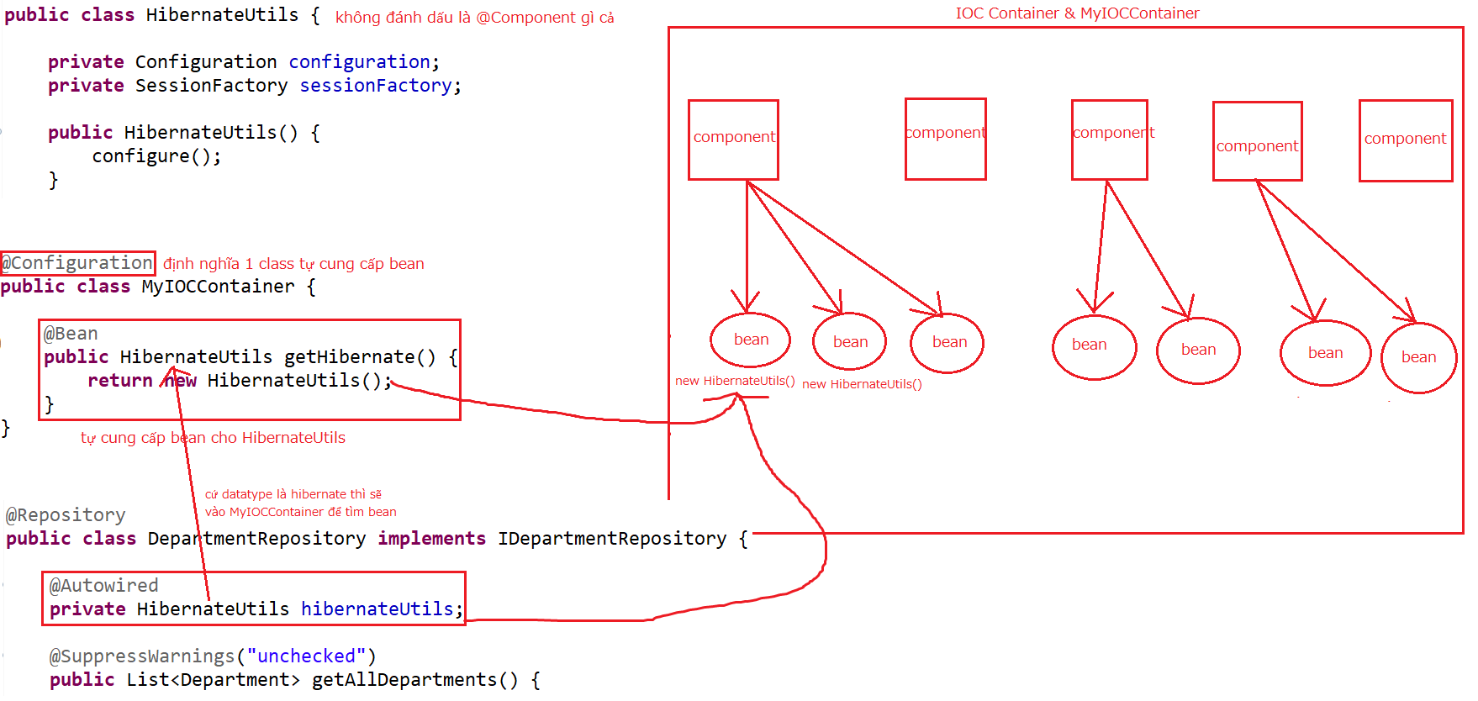
Spring Core
  @Configuration

Slide 31
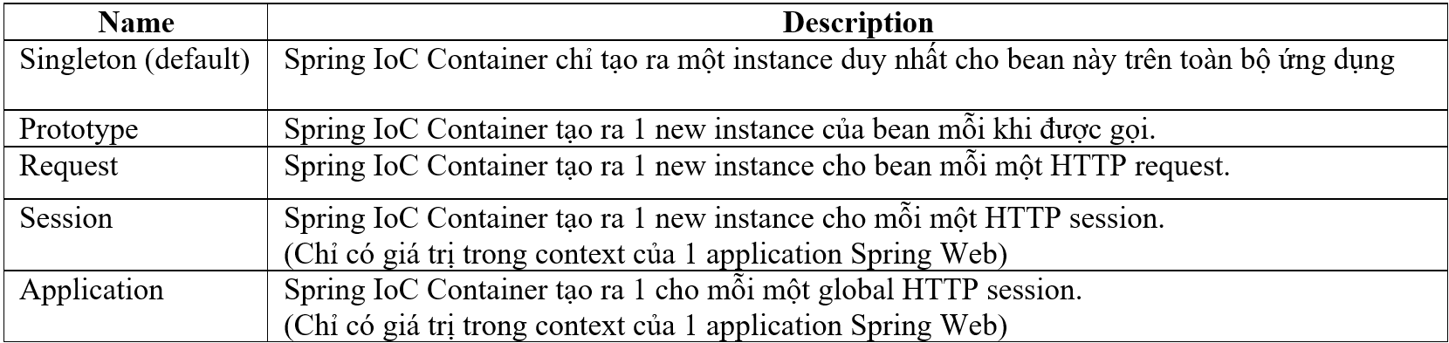
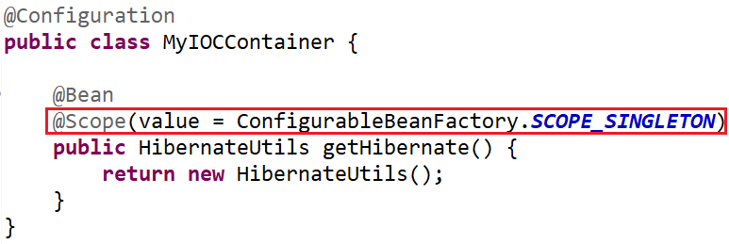
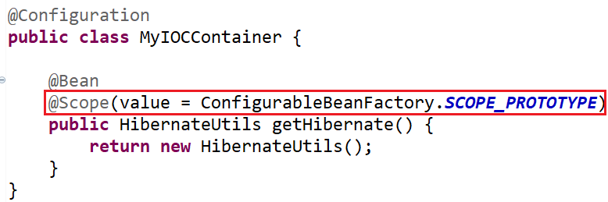
Spring Core
  @Scope

Slide 32
Spring Core
  @Autowired
  3 ways:
    On Field
    On Constructor
    On Setter
  @Qualifier & @Primary

Slide 33
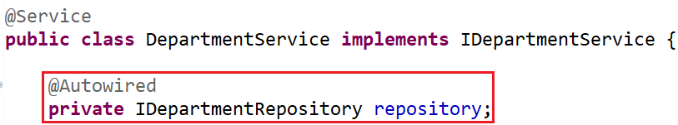
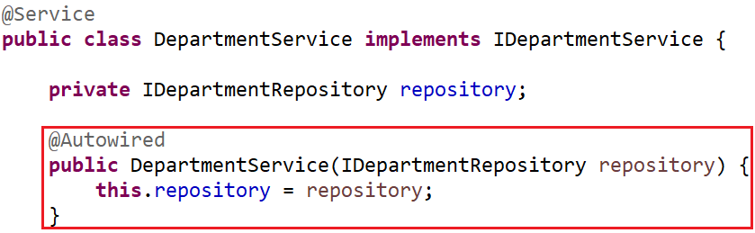
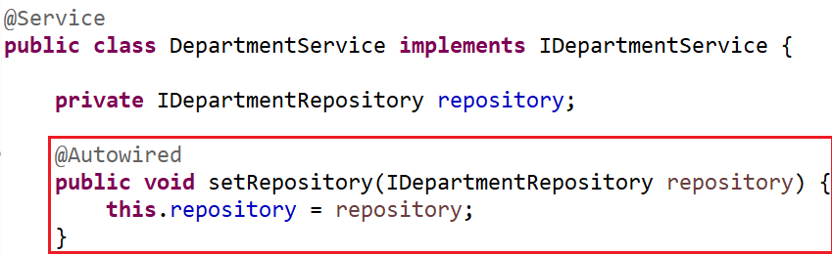
Spring Core
On Field
On Constructor
On Setter

Slide 34
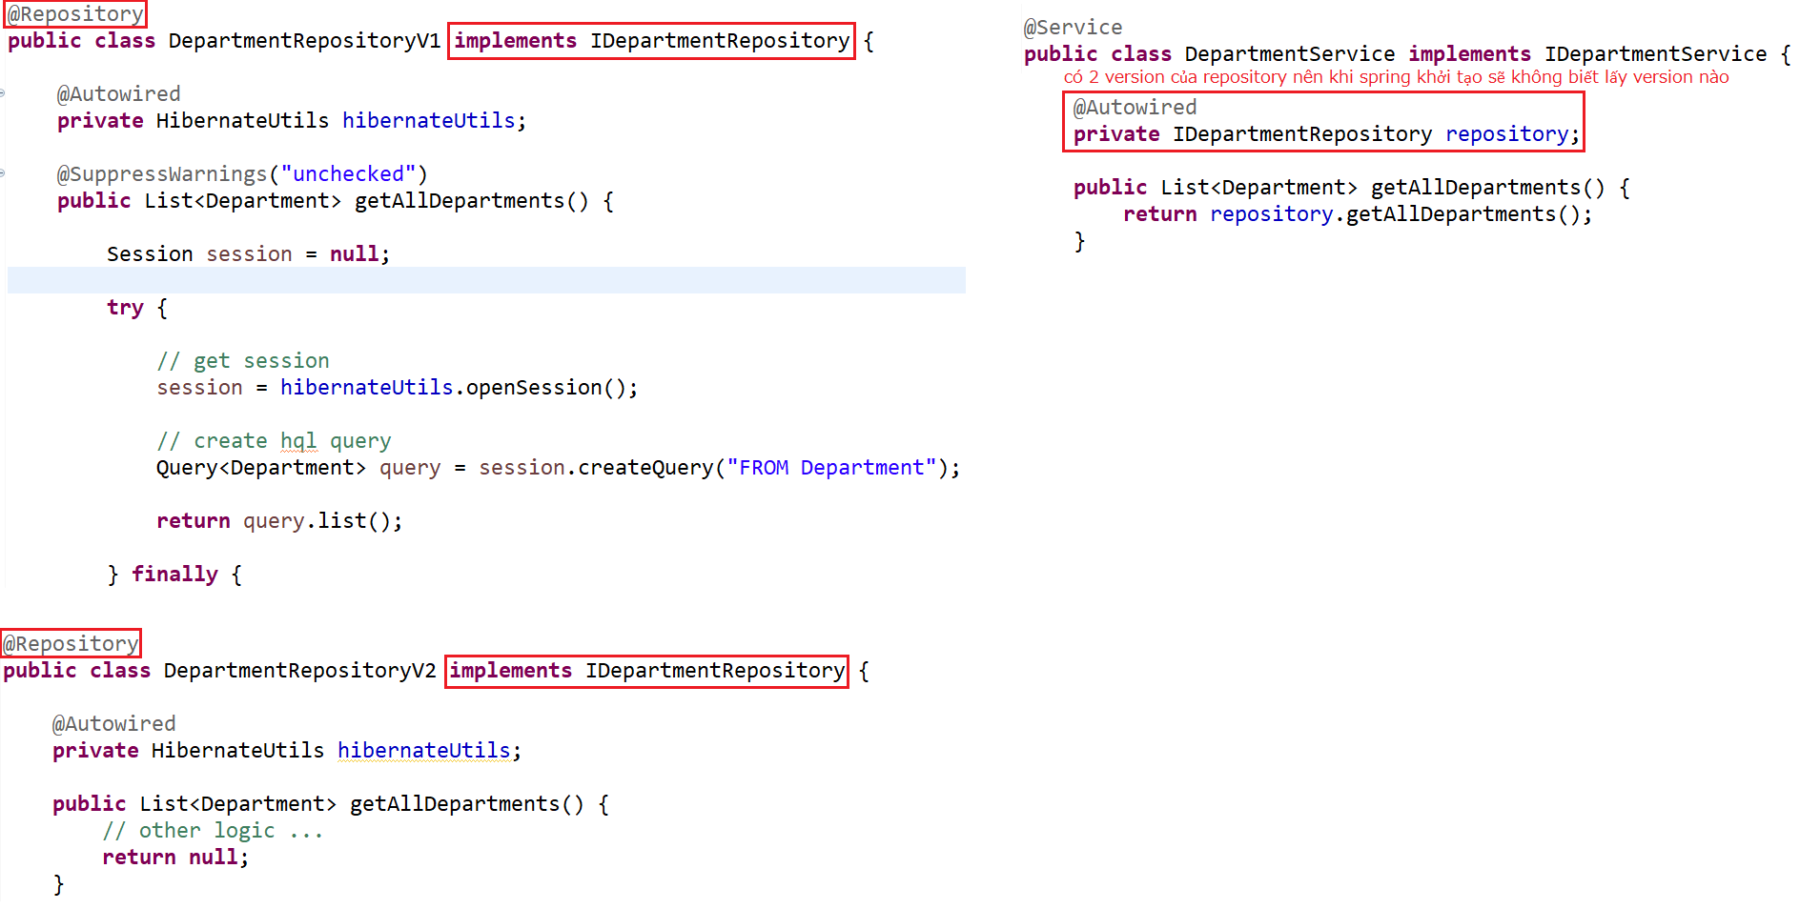
Spring Core
  @Qualifier & @Primary
    Error

Slide 35
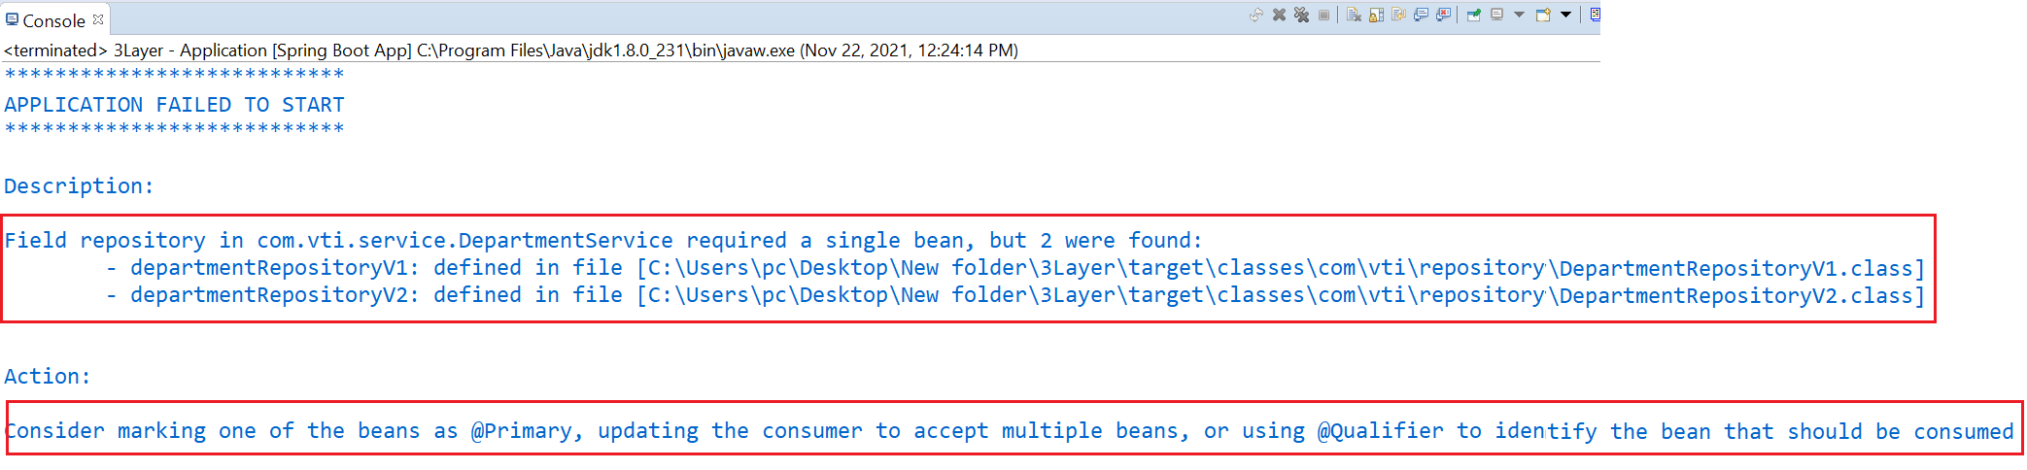
Spring Core
Error

Slide 36
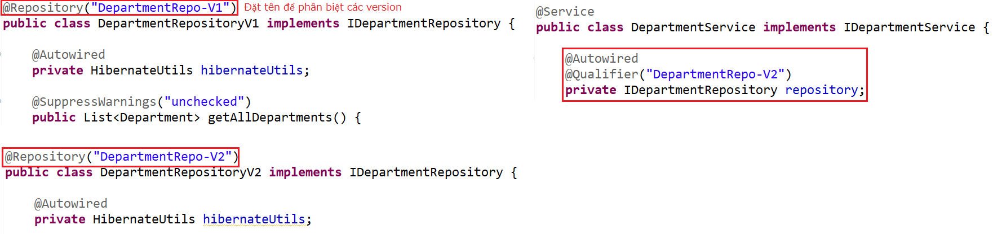
Spring Core
  Fix by @Qualifier

Slide 37
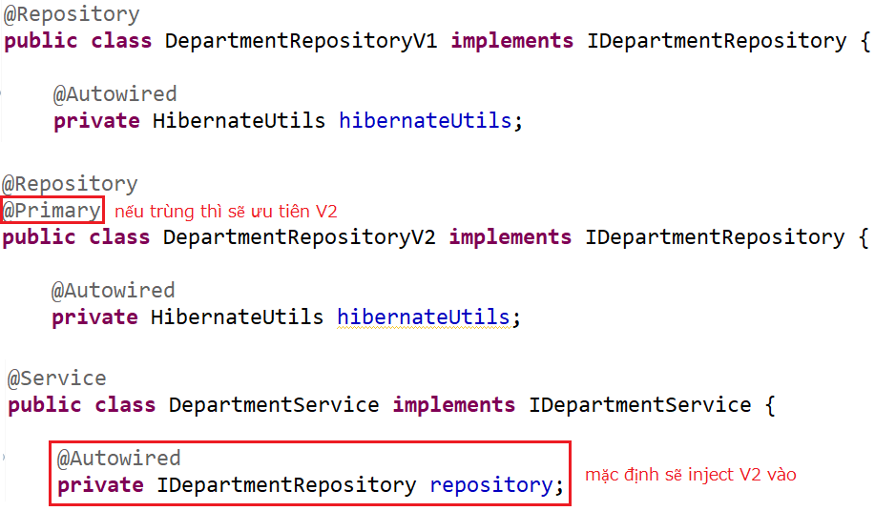
Spring Core
  Fix by @Primary

Slide 38
Spring Introduction
Java platform, Open-source
Provides comprehensive infrastructure support for developing Java applications
Design follows DI & IOC, AOP
Home Page: https://spring.io

Slide 39
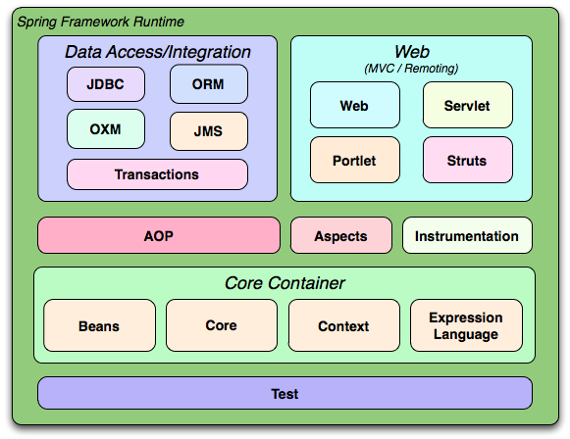
Spring Introduction
Multiple modules

Slide 40
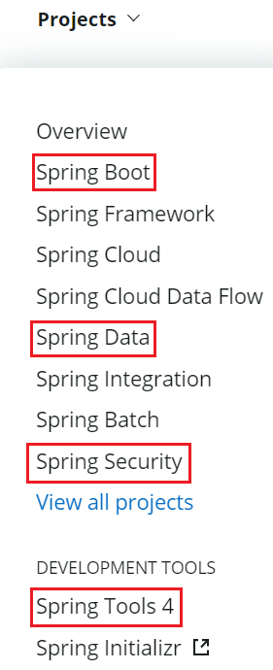
Spring Introduction
Projects
  Spring Core (Current Lesson)
  Spring Boot (Previous Lesson)
  Spring Data (Next Lesson)
  Spring Security (Next Lesson)
https://spring.io/projects

Slide 41
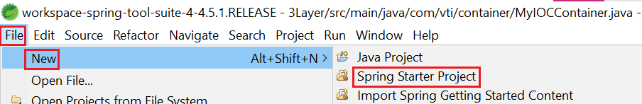
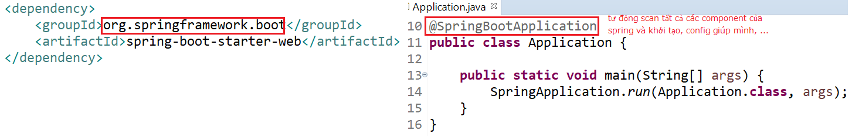
Spring Introduction
Spring Core
  IOC & DI Spring Boot
Spring Boot
  Help develop and run applications quickly
  Easy to create Spring Project, auto config tomcat (server), libraries, ...

Slide 42
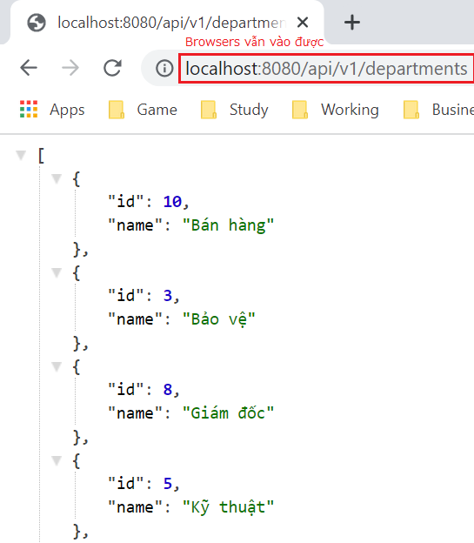
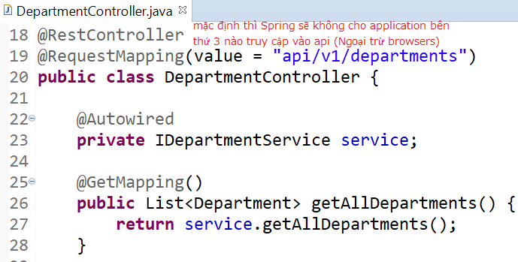
Other
@CrossOrigin

Slide 43
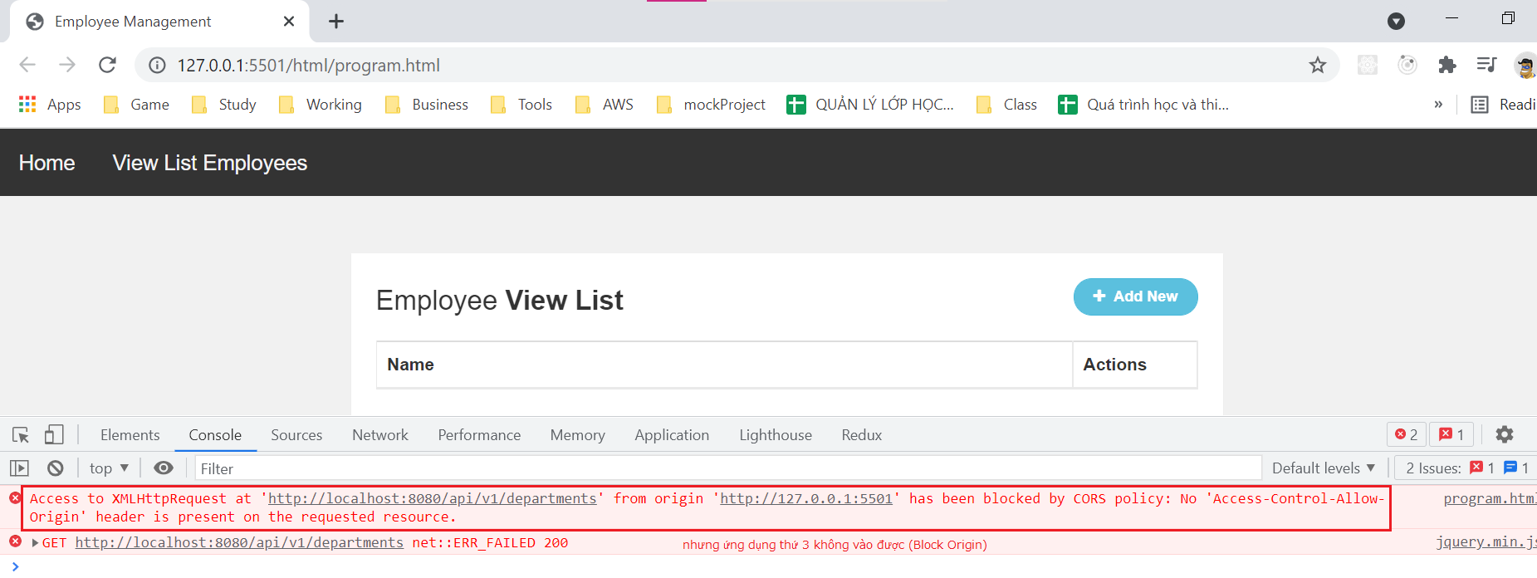
Other
Error

Slide 44
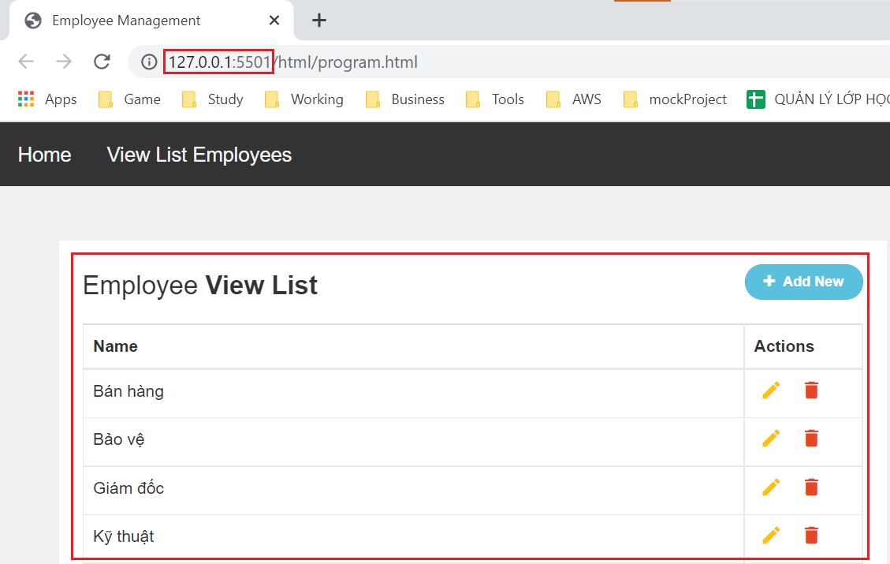
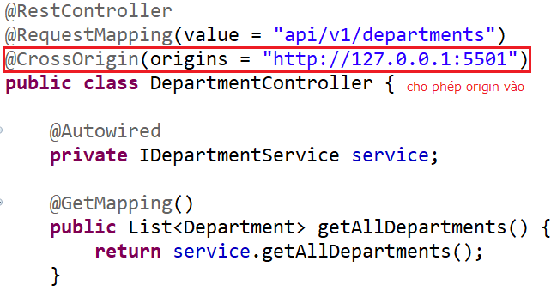
Other

Slide 45
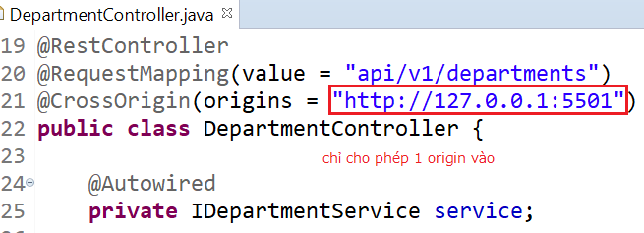
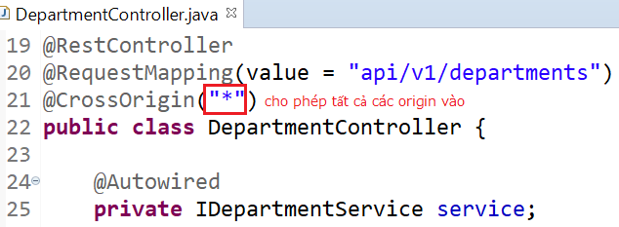
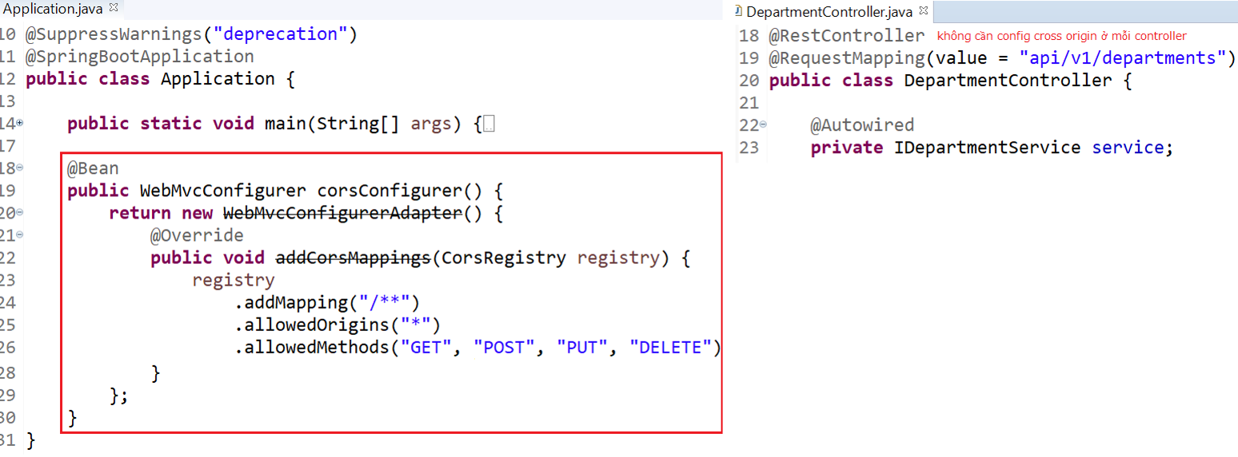
Other
Apply to Each Controller
Apply to All Controllers

Slide 46
Reference
https://www.baeldung.com
https://spring.io/projects/spring-boot
https://spring.io/guides#getting-started-guides

Slide 47
Q & A
Copyright © VTI Academy All Rights Reserved

